Slide 1
Deep Learning
UNIT-I
Introduction: Historical Trends in Deep Learning, The Many Names and Changing Fortunes of Neural Networks, Increasing Dataset Sizes, Increasing Model Sizes, Increasing Accuracy, Complexity and Real-World Impact.
UNIT-II:
Deep Feed forward Networks: Learning XOR, Gradient-Based Learning, Hidden Units, Architecture Design, Back Propagation and Other Differentiation Algorithms.

Slide 2
UNIT-III
Regularization for Deep Learning: Parameter Norm Penalties, Early Stopping, Dropout; Optimization for Training Deep Models: How Learning Differs from Pure Optimization, Challenges, Basic Algorithms, Parameter Initialization Strategies, Algorithms with Adaptive Learning Rates, Optimization Strategies and Meta-Algorithms.

Slide 3
UNIT-IV
Convolution Networks: The Convolution Operation, Motivation, Pooling, Convolution and Pooling as an Infinitely Strong Prior, Variants of Basic Convolution Functions, Structured Outputs, Data Types, Efficient Convolution Algorithms, Random or Unsupervised Features, The Neuroscientific Basis for Convolutional Networks, Convolutional Networks and the History of Deep Learning.

Slide 4
UNIT-V
Sequence Modeling- Recurrent and Recursive Nets: Unfolding Computational Graphs, Recurrent Neural Networks, Bidirectional RNNs, Encoder-Decoder Sequence-to-Sequence Architectures, Deep Recurrent Networks, Recursive Neural Networks, The Challenge of Long-Term Dependencies, Echo State Networks, Leaky Units and Other Strategies for Multiple Time Scales, LSTM and Other Gated RNNs, Explicit Memory.

Slide 5
Textbooks:
1. Deep Learning, Ian Goodfellow, YoshuaBengio, and Aaron Courville, MIT Press.
Reference Books:
1. Neural Networks and Deep Learning, Charu C. Aggarwal, Springer.
2. Fundamentals of Deep Learning, Nikhil Buduma, 1st Edition, O‘Reilly

Slide 6
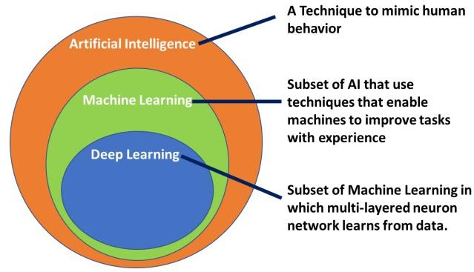
AI Vs ML Vs DL

Slide 7
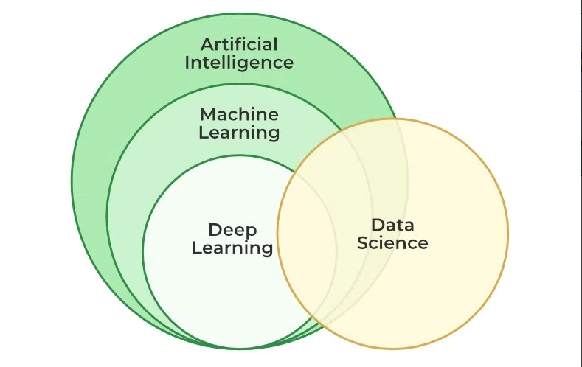

Slide 8
Machine Learning | Deep Learning
Apply statistical algorithms to learn the hidden patterns and relationships in the dataset. | Uses artificial neural network architecture to learn the hidden patterns and relationships in the dataset.
Can work on the smaller amount of dataset | Requires the larger volume of dataset compared to machine learning
Better for the low-label task. | Better for complex task like image processing, natural language processing, etc.
Takes less time to train the model. | Takes more time to train the model.
A model is created by relevant features which are manually extracted from images to detect an object in the image. | Relevant features are automatically extracted from images. It is an end-to-end learning process.
Less complex and easy to interpret the result. | More complex, it works like the black box interpretations of the result are not easy.
It can work on the CPU or requires less computing power as compared to deep learning. | It requires a high-performance computer with GPU.

Slide 9
Artificial Intelligence
Artificial Intelligence is basically the mechanism to incorporate human intelligence into machines through a set of rules (algorithm). AI is a combination of two words: “Artificial” meaning something made by humans or non-natural things and “Intelligence” meaning the ability to understand or think accordingly. Another definition could be that “AI is basically the study of training your machine (computers) to mimic a human brain and it’s thinking capabilities”.

Slide 10
Machine Learning
Machine Learning is basically the study/process which provides the system(computer) to learn automatically on its own through experiences it had and improve accordingly without being explicitly programmed. ML is an application or subset of AI. ML focuses on the development of programs so that it can access data to use it for themselves. The entire process makes observations on data to identify the possible patterns being formed and make better future decisions as per the examples provided to them. The major aim of ML is to allow the systems to learn by themselves through the experience without any kind of human intervention or assistance.

Slide 11
Deep Learning
Deep Learning is basically a sub-part of the broader family of Machine Learning which makes use of Neural Networks(similar to the neurons working in our brain) to mimic human brain-like behavior. DL algorithms focus on information processing patterns mechanism to possibly identify the patterns just like our human brain does and classifies the information accordingly. DL works on larger sets of data when compared to ML and prediction mechanism is self-administered by machines.

Slide 12
Deep learning is a subset of machine learning, which is essentially a neural network with three or more layers. These neural networks attempt to simulate the behavior of the human brain—albeit far from matching its ability— allowing it to “learn” from large amounts of data.

Slide 13

“Traditional” machine learning:
handcrafted features
learned classifier
cat
Deep, “end-to-end” learning:
learned low-level features
learned mid-level features
learned high-level features
learned classifier
cat

Slide 14
History of Deep Learning Over the Years
The history of deep learning dates back to 1943 when Warren McCulloch and Walter Pitts created a computer model based on the neural networks of the human brain. They used a combination of mathematics, Statistics and algorithms they called threshold logic to mimic the thought process. Since then, deep learning has evolved steadily, over the years with two significant breaks in its development. The development of the basics of a continuous Back Propagation Model is credited to Henry J. Kelley in 1960.

Slide 15
Importance of Deep Learning
Machine learning works only with sets of structured and semi-structured data, while deep learning works with
both structured and unstructured data.
Deep learning algorithms can perform complex operations efficiently, while machine learning algorithms cannot.
Machine learning algorithms use labeled sample data to extract patterns, while deep learning accepts large volumes of data as input and analyzes the input data to extract features out of an object
The performance of machine learning algorithms decreases as the number of data increases; so to maintain the performance of the model, we need a deep learning

Slide 16
Stuart Dreyfus came up with a simpler version based only on the chain rule in 1962. The concept of back propagation existed in the early 1960s but only became useful until 1985.

Slide 17
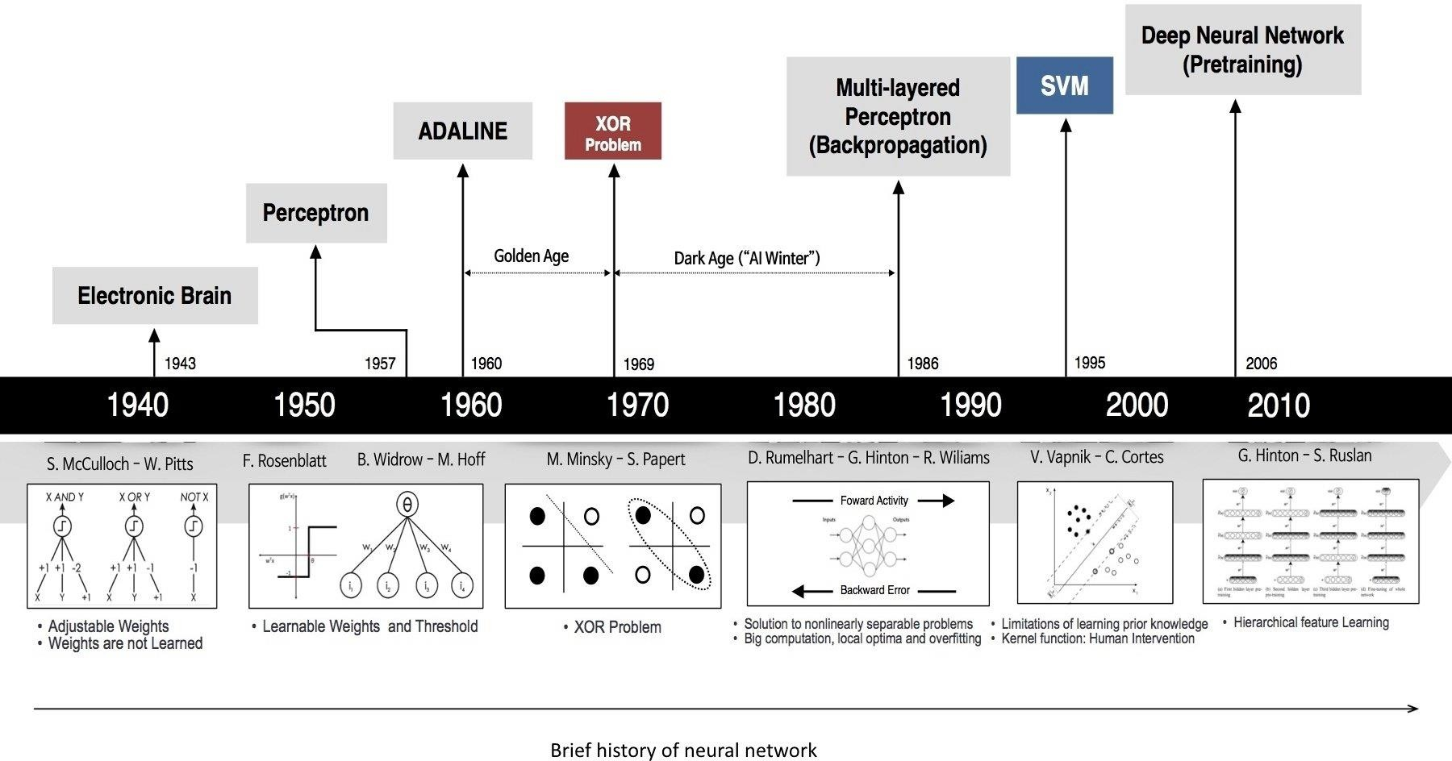

Slide 18
"Electronic brain" is a term that's often used to refer to a computer or any electronic system designed to perform tasks that involve processing information, calculations, and decision-making—functions that are similar to those of the human brain.
Perceptron is a basic building block of artificial neural networks, inspired by the way biological neurons work in the human brain. It's a type of artificial neuron or node that takes multiple binary inputs, applies weights to them, sums them up, and produces an output. The output is usually passed through an activation function to determine the final output of the perceptron.

Slide 19
Adaline which stands for Adaptive Linear Neuron, is a type of artificial neural network and is closely related to the Perceptron. It was introduced by Bernard Widrow and Ted Hoff in 1960. Adaline shares similarities with the Perceptron but has a key difference in the learning algorithm.
While the Perceptron uses a step function as its activation function, Adaline uses a linear activation function. The key innovation of Adaline lies in its learning rule, which is a form of supervised learning called the Widrow-Hoff rule or delta rule. This rule adjusts the weights of the network based on the difference between the predicted output and the actual target output, aiming to minimize the error.

Slide 20
The XOR problem refers to a specific challenge in the context of artificial neural networks, particularly early single-layer Perceptrons. XOR (exclusive or) is a logical operation that outputs true only when the number of true inputs is odd. The XOR problem is not linearly separable, which means a single-layer Perceptron cannot learn to correctly classify XOR inputs.
Multi-Layer Perceptron (MLP) is a type of artificial neural network with multiple layers of nodes or neurons. Unlike the single-layer Perceptron, an MLP consists of an input layer, one or more hidden layers, and an output layer. Each layer has multiple nodes, and connections between nodes are associated with weights.

Slide 21
Support Vector Machine (SVM) is a supervised machine learning algorithm used for classification and regression tasks. In the context of classification, SVM aims to find a hyperplane that best separates the data into different classes. The term "support vector" refers to the data points that are crucial in determining the optimal hyperplane.
The key idea of SVM is to find the hyperplane with the maximum margin between classes. The margin is the distance between the hyperplane and the nearest data point from each class. SVM aims to maximize this margin, which helps improve the model's generalization.

Slide 22
The Many Names and Changing Fortunes of Neural Networks
It started in the 1940s! Deep learning is introduced and it is old field. It was known as Cybernetics in 1940s-1960s. Then Connectionism in the duration 1980s-1990s. And now Deep Learning in 2012……?
Early forms of learning algorithms were to mimic biological learning hence the name Artificial Neural networks. They’re inspired by biological brains. But it’s not used to be realistic models of biological brains.

Slide 23
The central idea of connectionism is that lots of connected neurons can give rise to intelligent behaviour.
Neuroscience inspires deep learning, but deep learning also takes inspiration from linear algebra, probability, information theory and numerical optimization.

Slide 24
Cybernetics — During 1940–1960
Connectionism — During 1980–1990
Deep Learning — Since 2012….
Electronic Brain (1940-1943-1950)
Perceptron (1950-1957-1960)
Adaline (1960 )
XOR Problem (1970) Golden Age
Dark Age (1970-1990)
Multi-Layered Perceptron (1990-2000)
Support Vector Machine (2000-2012)
Deep Neural Network (2012……)

Slide 25
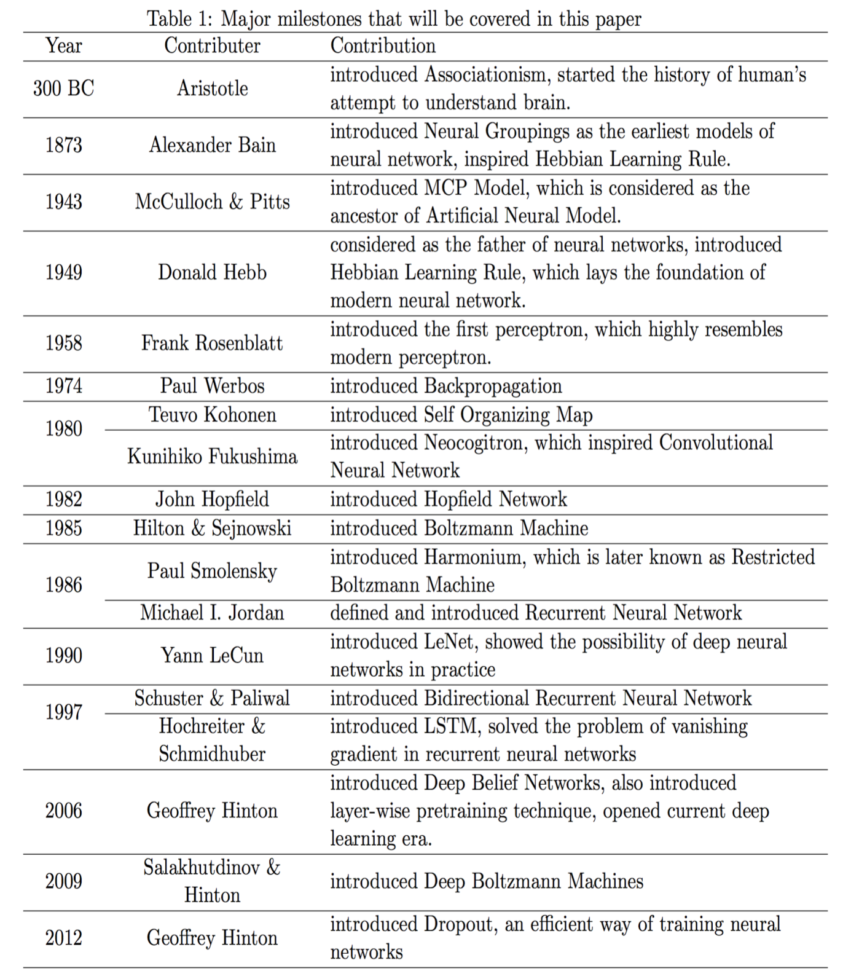
From: Wang & Raj: On the Origin of Deep Learning (2017)

Slide 26
Increasing Dataset sizes
Increasing the size of a dataset is a common technique used to improve the performance of deep learning models.
The amount of data required to train a model depends on the complexity of the problem and the model architecture.
It is important to note that increasing the size of a dataset does not always lead to better performance.

Slide 27
Data Augmentation
Data augmentation is a technique of artificially increasing the training set by creating modified copies of a dataset using existing data. It includes making minor changes to the dataset or using deep learning to generate new data points.
Generate additional training examples by applying various transformations to your existing data. For example images, this could include rotations, flips, zooming, cropping and changes in brightness or contrast can be used to create new images from existing ones.

Slide 28
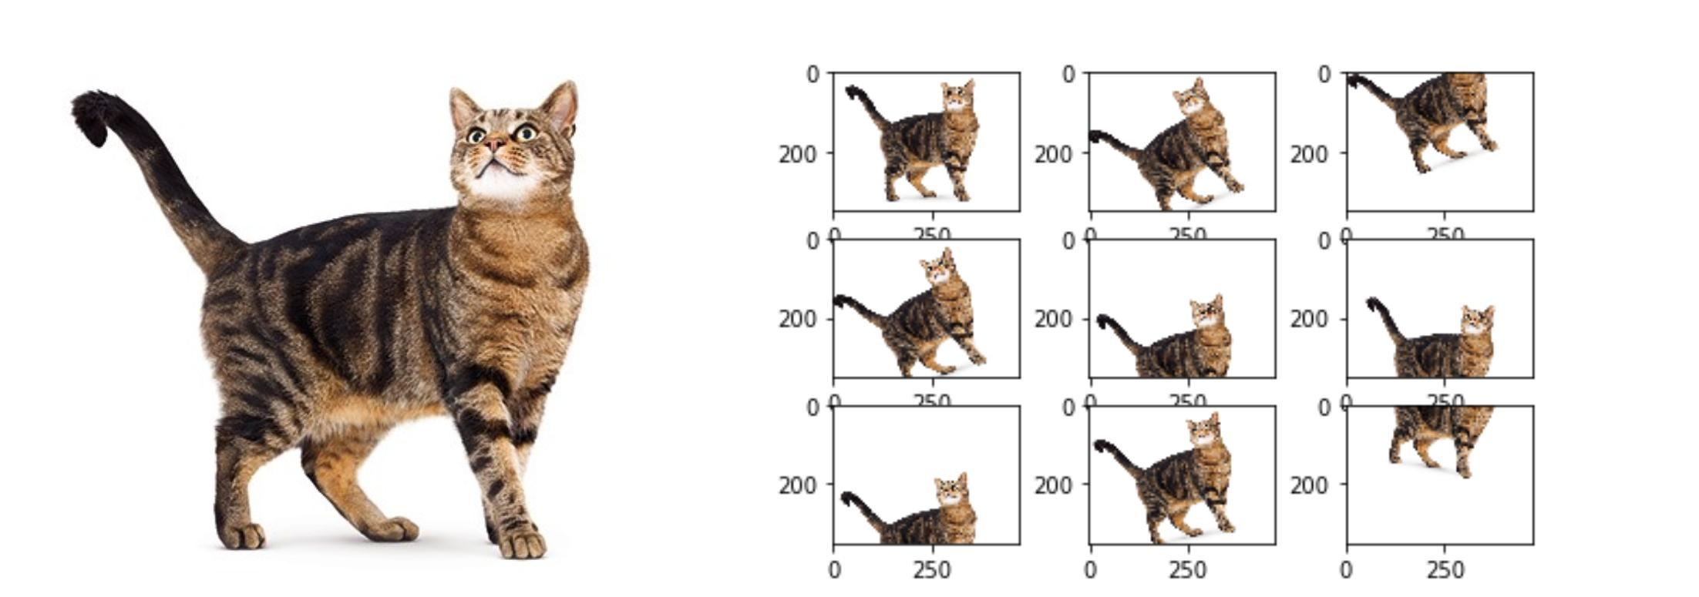

Slide 29
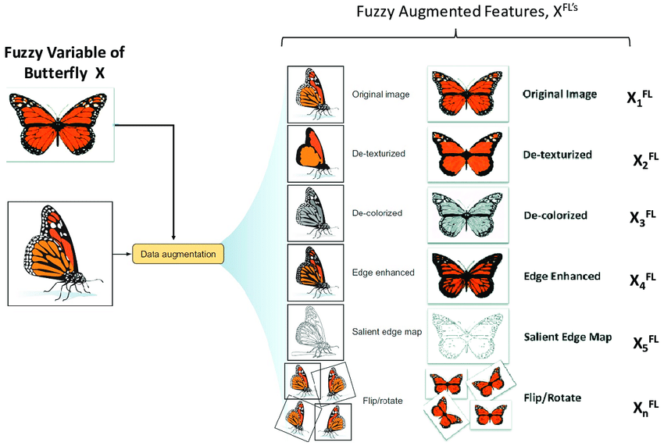

Slide 30
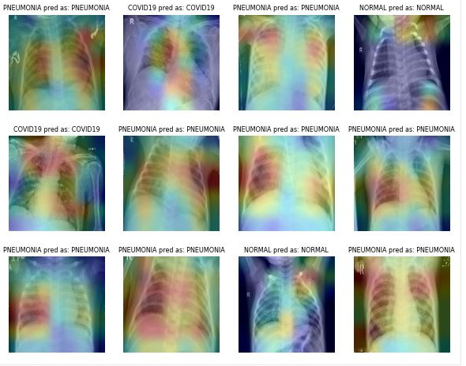

Slide 31
Collect More Data: This might seem obvious, but collecting more real-world data is often the most straightforward way to increase your dataset size. Ensure the new data is diverse and representative of the scenarios your model will encounter.
Transfer Learning: Start with a pre-trained model on a larger dataset and fine-tune it on your specific task. This leverages the knowledge gained from the larger dataset to improve performance on your smaller dataset.

Slide 32
Data Recycling: Reuse your existing data by creating different subsets or views of it. For example, if you have time-series data, you can create multiple time windows or intervals to increase the effective size.
Text Augmentation: Techniques such as synonym replacement, random insertion, and random deletion can be used to create new text samples from existing ones.
Audio Augmentation: Techniques such as adding noise, changing pitch, and time stretching can be used to create new audio samples from existing ones.

Slide 33
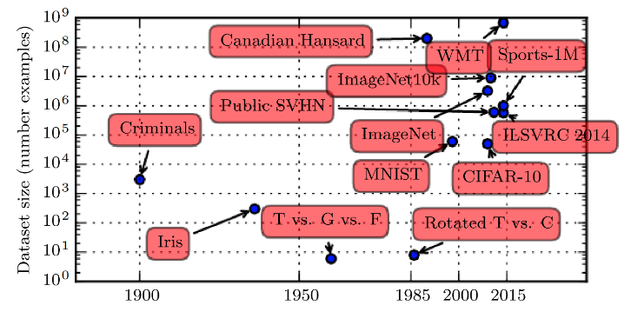
Increasing Dataset Sizes

Slide 34
International Resource Information System (IRIS): This is small dataset from 1936 is often used for testing out machine learning algorithms and visualizations. its simplicity, real-world relevance, and its utility as a teaching and benchmarking tool in the field of data science and analysis.
Street View House Numbers (SVHN): Is a digit classification benchmark dataset that contains 600,000 32×32 RGB images of printed digits (from 0 to 9) cropped from pictures of house number plates. The cropped images are centered in the digit of interest, but nearby digits and other distractors are kept in the image

Slide 35
Canadian Hansard: Hansard is a record of speeches, questions and answers and procedural events in the Legislative Council and Legislative Assembly and is known as Parliamentary Debates (Hansard).
ImageNet: This labeled object image database is used in the ImageNet Large Scale Visual Recognition Challenge. It includes labeled objects, bounding boxes, descriptive words, and SIFT features. There are a total of 14,197,122 instances. It has 22000 labels in total.

Slide 36
CIFAR-10: dataset (Canadian Institute For Advanced Research) is a collection of images that are commonly used to train machine learning, Deep Learning and computer vision algorithms. It is one of the most widely used datasets for machine learning research.

Slide 37
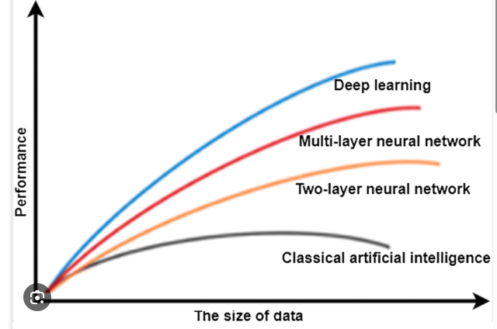

Slide 38
Increasing Model Sizes
1. Add More Layers:
Increase the depth of your neural network by adding more layers. This can help the model learn more complex representations.
2. Increase the Number of Neurons:
  In existing layers, you can increase the number of neurons (nodes). This allows each layer to capture more diverse features.
3. Wider Layers:
  Make the layers wider by increasing the number of neurons in each layer. This can help the model generalize better.

Slide 39
4. Use Pre-trained Models:
  Start with a pre-trained model and add more layers or neurons to it. Transfer learning can save training time and resources.
5. Adjust Hyper parameters:
  Experiment with hyper parameters such as learning rate, batch size, Epochs, and regularization strength. Larger models may require different hyper parameter settings.
6. Regularization Techniques:
  Apply regularization techniques like dropout or L2(adds the sum of squared weights to the loss function) regularization to prevent overfitting, especially when dealing with larger models.

Slide 40
7. Ensemble Methods:
  Train multiple models and combine their predictions using ensemble methods. This can improve performance and robustness.
8. Use Advanced Architectures:
  Consider using more advanced architectures like attention mechanisms or capsule networks, depending on the nature of your problem.
9. Data Augmentation:
  Increase the amount of training data through data augmentation techniques. This can help the model generalize better to different variations of input

Slide 41
10. Optimized Hardware:
If computational resources allow, use hardware accelerators like GPUs or TPUs to speed up training of larger models.
11. Use larger convolutional filters:
In convolutional neural networks, using larger filters can increase the model size. However, this can also lead to overfitting. Regularization techniques such as max pooling can help prevent overfitting .

Slide 42
Increasing Accuracy
Add More Data.
Eliminate Missing and Outlier Values.
Feature Engineering.
Feature Selection.
Multiple Algorithms.
Algorithm Tuning.
Ensemble Methods.
Cross Validation.

Slide 43
Complexity and Real-World Impact
In deep learning, model complexity is a fundamental problem that can be categorized into expressive capacity and effective model complexity. Expressive capacity refers to the ability of a deep learning model to solve complex problems, while effective model complexity refers to the ability of a model to generalize well to new data.
The complexity and dynamic nature of real-world problems present challenges in designing effective deep learning models.. Deep learning has been applied to various domains such as speech recognition, healthcare, autonomous vehicles, cyber security, predictive analytics, and more

Slide 44
The complexity of deep learning plays a crucial role in enabling these vehicles to navigate and make decisions in real-time.
In autonomous driving systems, deep learning models are trained on vast amounts of data from sensors like cameras, lidar and radar. The complexity arises as these models need to process and understand diverse and dynamic real-world scenarios, such as identifying pedestrians, other vehicles, traffic signs, and interpreting complex road environments.

Slide 45
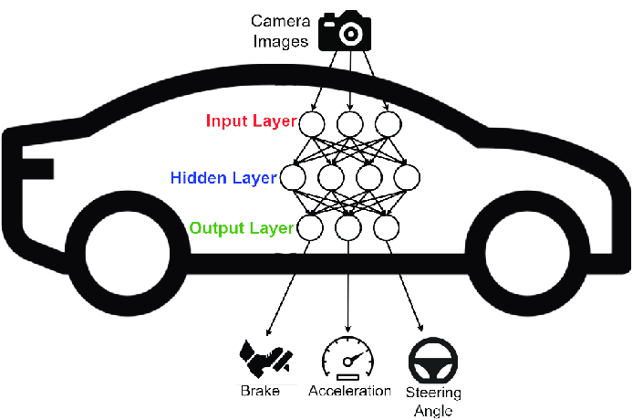

Slide 46
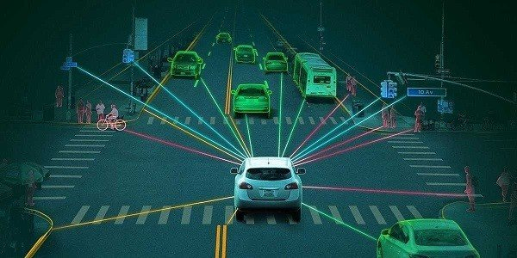

Slide 47
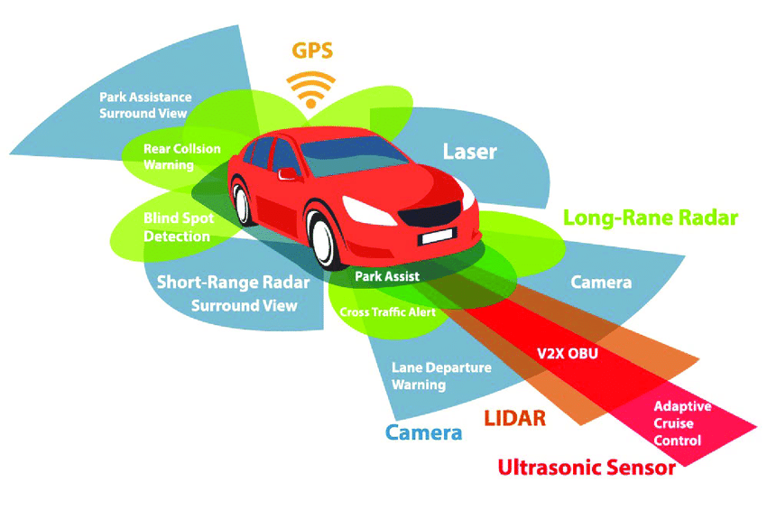

Slide 48
GPS
LiDAR
RADAR
AI
SENSOR
Prebuilt Mapping Technology
Waymo
Bumper Mounted Radar
Inertial Measurement Units (IMU)
Perceptron
Cameras and Camera vision
Laser focus
Ultrasonic
Object recognition

Slide 49
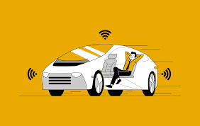

Slide 50
The real-world impact comes into play when these trained models are deployed in actual self-driving cars. These vehicles use deep learning algorithms to continuously analyze their surroundings, make split-second decisions, and navigate safely through traffic. The ability to adapt to unforeseen situations, learn from experience, and improve over time is where the true power of deep learning in autonomous driving shines.
Other examples of real-time deep learning applications include facial recognition systems, medical diagnostics, and predictive Anlytics.

Slide 51
Object Detection and Segmentation: Self-driving cars, Image search engine.
Image Classification: Image tagging and Disease diagnosis from medical images.
Personalized Recommendations: E-commerce, Streaming services item-item
Collaborative Filtering: Retail, Music streaming platforms
Matrix Factorization: Movie recommendations, Book recommendations
Fraud Detection: Financial services, E-commerce platforms

Slide 52
